Slide 1
HOUSING BUY VS RENT DECISION SUPPORT TOOL
MIS 4460
Presented to: Professor Osman Aydas
Presented by: Aswini Sivakumar, Deepa Palariya, Rana Hamdan

Slide 2
PROBLEM ADDRESSED
Deciding between buying and renting a home is a complex process that involves significant financial and personal considerations. It's crucial to understand when owning a home is financially advantageous and when it's not. Mortgage calculators may underestimate monthly payments by only considering principal and interest payments, but there are additional expenses to account for, such as homeowners insurance, property taxes, association fees, and maintenance costs. This decision support tool will help evaluate the financial trade offs of renting versus buying based on customers specific financial circumstances and the duration of homeownership.

Slide 3
INTRODUCTION TO THE TOOL
Data source: Zillow housing data (MI, USA)
https://www.zillow.com/research/data/
This decision support tool offers users two options. They can input a zip code to view the average buying and renting prices in the area based on the gathered data. Alternatively, for a more personalized experience, users can input their desired buying and renting prices, which will be used to calculate the present value benefit of owning versus renting a home. In both cases, the user can input additional data such as property tax rate, annual insurance, assumed annual appreciation, assumed marginal income tax rate, general inflation, and other relevant factors that may impact the final decision.

Slide 4
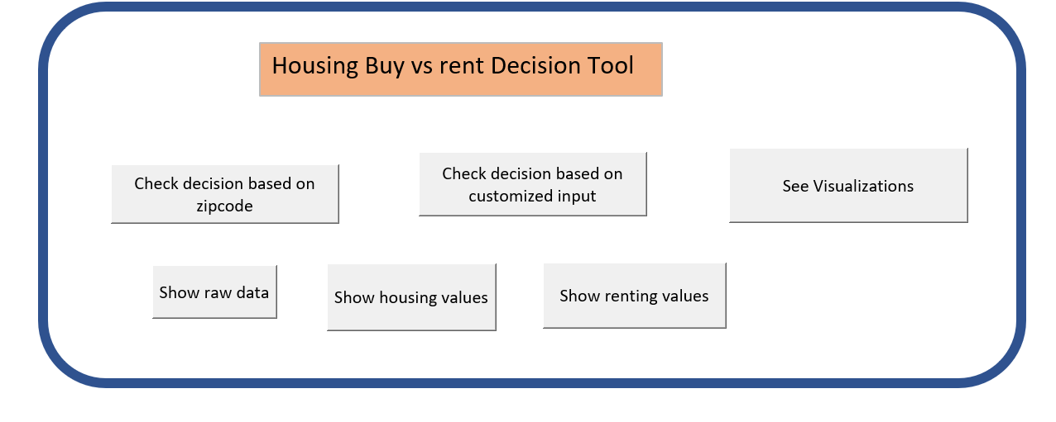
MAIN PAGE

Slide 5
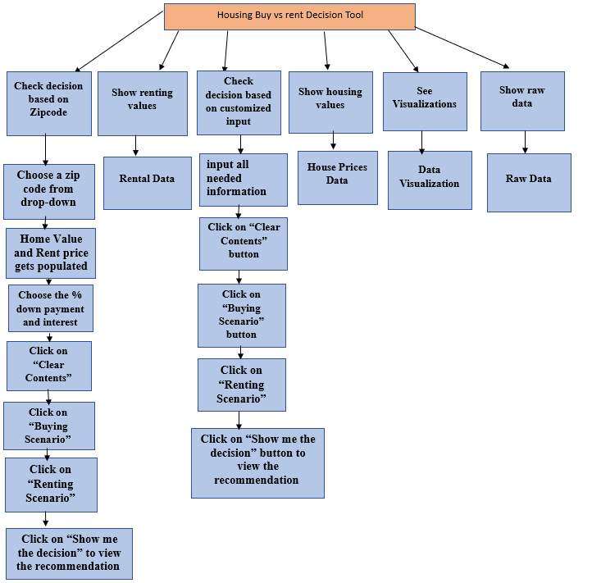

Slide 6
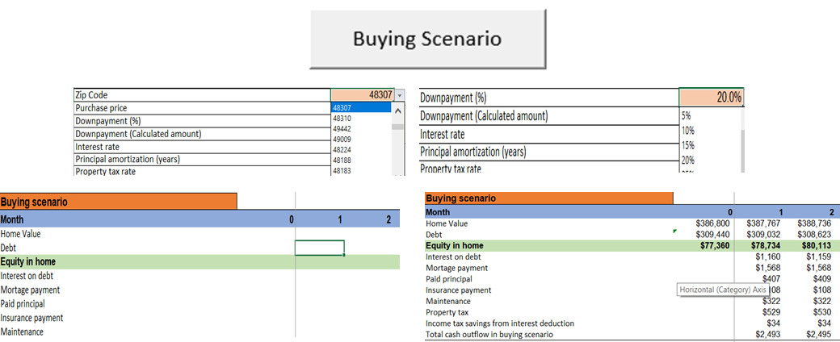
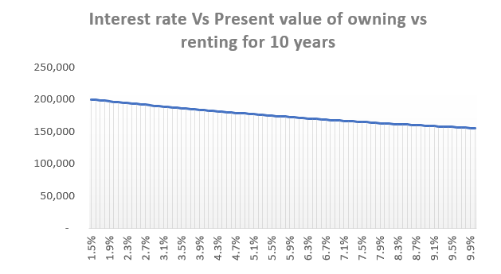
DEMO
A user after inputting the details when clicks on buying scenario and renting scenario the values based on the parameters set pops.
The spreadsheet also shows a graph representing Interest rate Vs present value of owning Vs renting a house allowing a customer to see the benefits of both visually.

Slide 7
CAPABILITIES
Evaluate the present value benefit of owning versus renting for ten years based on the user's individual situation.
Helps calculate future value of a house based on inputs such as purchase price, interest rates, annual appreciation.
Illustrates the benefits of renting/owing and cost savings associated to it aiding users in planning their finances.
Demonstrate the impact of interest rates on the feasibility of buying a house versus renting.
Supplies users with essential information on the average costs of buying and renting in 125 zip codes situated in MI.
The tool allows users to tailor the experience to their specific circumstances.

Slide 8
LIMITATIONS
The tool is restricted to 125 zip codes in MI,but can be employed for other zip codes beyond the existing dataset once the necessary data is obtained.
Unable to acquire a bigger dataset to utilize for creating visualizations.
Ideally, maintenance expenses would vary with the age of the house, but since the dataset does not contain information on the age of the house, we applied a general rule of 1% of the home value.

Slide 9
DEVELOPMENT ANALYSIS AND CHALLENGES
Development :
VBA
Excel functions
Graphs
Tableau Visuals
Challenges :
Acquiring data from authentic websites.
Developing the VBA code to display both the scenarios

